Slide 1
JavaScript

Slide 2
Note to the class
I have incorporated anything that needs to be understood for the quizzes in this PowerPoint.
Use this gist for code demonstrating much of what is covered in the slide deck
https://gist.github.com/43dbd897cd04ff223ecb4a66c12f45cd
I tried to be a responsible programmer and include helpful comments

Slide 3
The topics to be covered
Using functions and objects
Working with JavaScript and the DOM
Changing DOM elements
Handling events
Troubleshooting code
Validating functionality
Minifying JavaScript

Slide 4
Where does my JS go?
You can put it in your HTML file between <script> </script> tags
But that mixes your MVC
Or better yet put it in a JS file, usually in a sub folder just for JS
<script src="js/domExperiments.js"></script>
HTML files separate out the View
JS files separate out the Controller logic
Your Model data comes from an API request in JSON format

Slide 5
Where should I put my <script> tag
Put it at the END of your HTML
I put it after the </BODY> tag and before the closing </HTML>
Why?
JS may need to do some initializing of the data on your page. It can not do that until your page is loaded
If you put the <script> tag at the top of the <body> your html has not yet loaded and your document.getElementById will not find the element because it has yet to be rendered

Slide 6
Using Functions
Functions encapsulate a frequently used task
DRY – Don’t Repeat Yourself
If something needs to be done in several parts of your code put that into a function

Slide 7
Calculating Grades
// Functions take us away from dealing with one specific student // our code gets generalized to be used for many function getStudentRecommendation (grade, name) { let recommendation; if ( grade < 70 ) { recommendation = "set up counseling session with " + name; } else if ( grade < 80 ) { // Maybe some extra practice is needed recommendation = "Assign more homework to bring up " + name + "'s scores"; } else if ( grade < 90 ) { // score is between 80 and 90 recommendation = "Give " + name + " a pat on the back"; } else { // score is >= 90 recommendation = "Ask " + name + " to tutor other students"; } return recommendation; }

Slide 8
A few pointers on functions
Name the function intelligently. They DO things, so I like to start their names with an action verb.
A function should not be aware of any information outside the scope of the function
Everything the function needs to be passed into it
The function has a single purpose.

Slide 9
There is a LOT more to methods
S - SRP (Single Responsibility Principle)
O - OCP (Open Closed Principle)
L - LSP (Liskov Substitution Principle)
I - ISP (Interface Segregation Principle)
D - DIP (Dependency Inversion Principle)
I only touched on the SRP principle. There is a lot more to consider at times

Slide 10
Objects

Slide 11
Objects
Kind of like Java and C# objects.
let name = “University of North Texas”;
name is an object.
It has functions associated with it
Copy chars - name.substring(0,10); // new string ’university’
Get one char – name.charAt(8); // ‘t’ remember to start at 0
Where is? - name.indexOf(‘N’); // returns 14
Object followed by a dot followed by the function that is part of that object
https://www.w3schools.com/jsref/jsref_obj_string.asp

Slide 12
Passing an argument into an Event Handler
The (e) is the parameter for our Event Handler.
e is the object that describes the event
In this case it is a mouse event
bgDiv.addEventListener('mousemove', (e) => { let color = getRandomColor(); bgDiv.style.backgroundColor = color; bgDiv.innerHTML = color + '<br><hr>(' + e.clientX + ", " + e.clientY + ')'; });

Slide 13
The Event Handler Object

Slide 14
The Event Handler Object
Let’s add a simple div to our web page
<div id = "bgDiv"></div>
We’ll add a mousemove event handler
bgDiv.addEventListener('mousemove', (e) => { let color = getRandomColor(); bgDiv.style.backgroundColor = color; bgDiv.innerHTML = color + '<br><hr>(' + e.clientX + ", " + e.clientY + ')'; });
The e is the event handler object.
From it we can get the X and Y coordinate of the mouse when the mouse moved

Slide 15
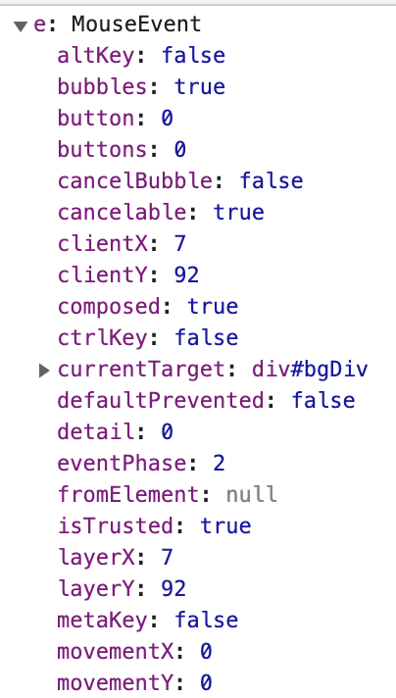
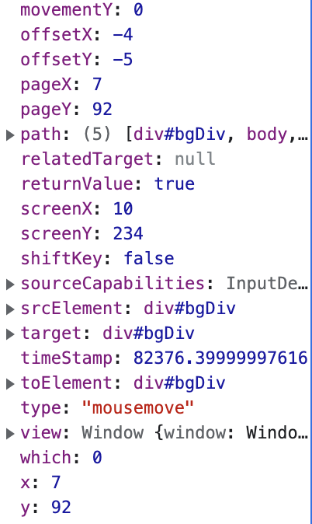
Passing an argument into an Event Handler
Each event has different data
What you see here is what is available to you for a mousemove event
You get different kinds of X and Y coordinates
You also get the currentTarget. Our div! bgDiv

Slide 16
JavaScript Objects
This is a good point to mention JS objects again
Our event object gives access to all attributes of this particular event
e.altKey or e.shiftKey tells you if those keys are depressed.
e.timestamp gives the time of the event
e dot whatever gives you the value of the attribute you need to reference
When you have an object your reference the name followed by a dot and the attribute from that object

Slide 17
Defining an event in the HTML (not preferred)
<button onclick="document.getElementById('demo').innerHTML = Date()">The time is?</button>
<button onclick="this.innerHTML = Date()">The time is?</button>
<button onclick="displayDate()">The time is?</button> <script>
function displayDate() {
document.getElementById("demo").innerHTML = Date();
}
</script>

Slide 18
Defining an Event Using addEventListener (preferred)
Why is it preferred?
You are not combining JavaScript and HTML in the same setting
All a part of a MVC pattern
.html is for HTML – the View, how the page looks
.js is for the JavaScript – the Controller, how the page acts

Slide 19
addEventHandler
You need a reference to the element requiring a handler
To select a single element? Use
querySelector, getElementById,
Need to add the same handler to multiple elements? Use
getElementsByTagName, getElementsByClassName, querySelectorAll

Slide 20
addEventHandler
let bgDiv = document.getElementById("bgDiv");
bgDiv.addEventListener('mousemove', (e) => { let color = getRandomColor(); bgDiv.style.backgroundColor = color; bgDiv.innerHTML = color + '<br><hr>(' + e.clientX + ", " + e.clientY + ')'; console.log ('(' + e.clientX + ", " + e.clientY + ')'); });

Slide 21
Available Events
https://www.w3schools.com/jsref/dom_obj_event.asp
There are a lot to choose from
The next page shows of few of the more popular

Slide 22
Some events
Event | When
load | an object has loaded
mouse: | down, up, enter, leave, move, out, over
 | the user presses a mouse button or moves over an element
paste | the user pastes some content in an element
reset | a form is reset
resize | the document view is resized
scroll | an element's scrollbar is being scrolled
search | the user writes something in a search field (for <input="search">)
submit | a form is submitted
Touch | touch: cancel, end, move, start
 | the touch is interrupted
wheel | the mouse wheel rolls up or down over an element
Event | When
blur | an element loses focus
click | the user clicks on an element
copy | the user copies the content of an element
cut | the user cuts the content of an element
dblclick | the user double-clicks on an element
drag: drag, start, end,… | an element is being dragged
drop | the dragged element is dropped
focus | an element gets focus
input | an element gets user input
keydown, up, press | the user is pressing a key

Slide 23
A note on one particular event
Load
A good habit is to put your <script> tag at the bottom of the page so the page is completely loaded and all screen elements are available for initialization
An alternative is to have a ‘load’ event that only triggers AFTER the page is loaded. Then you can put the <script> tag any where
Check out the gist referenced at the top of the slide deck for an example

Slide 24
Document Object Model

Slide 25
Working with DOM
The DOM – Document Object Model is a ‘database’ of ALL objects on your web page.
To access a screen element, you have several options.
Get the element by the id, tag, or name

Slide 26
Accessing elements on your page document.querySelector(CSS selectors)
querySelector returns the FIRST matching element or null
CSS selectors – for instance these selectors return the first
“h1” H1 on your page
“h1, h2” H1 or H2
“div.error” div with a class of error
“#demo” id = demo (SB only 1)
“.required” the class of required
“name=firstName” name attribute = firstName

Slide 27
What to see more examples of CSS Selectors?
https://www.w3schools.com/cssref/css_selectors.asp
The next slide is a sample of what can be used

Slide 28
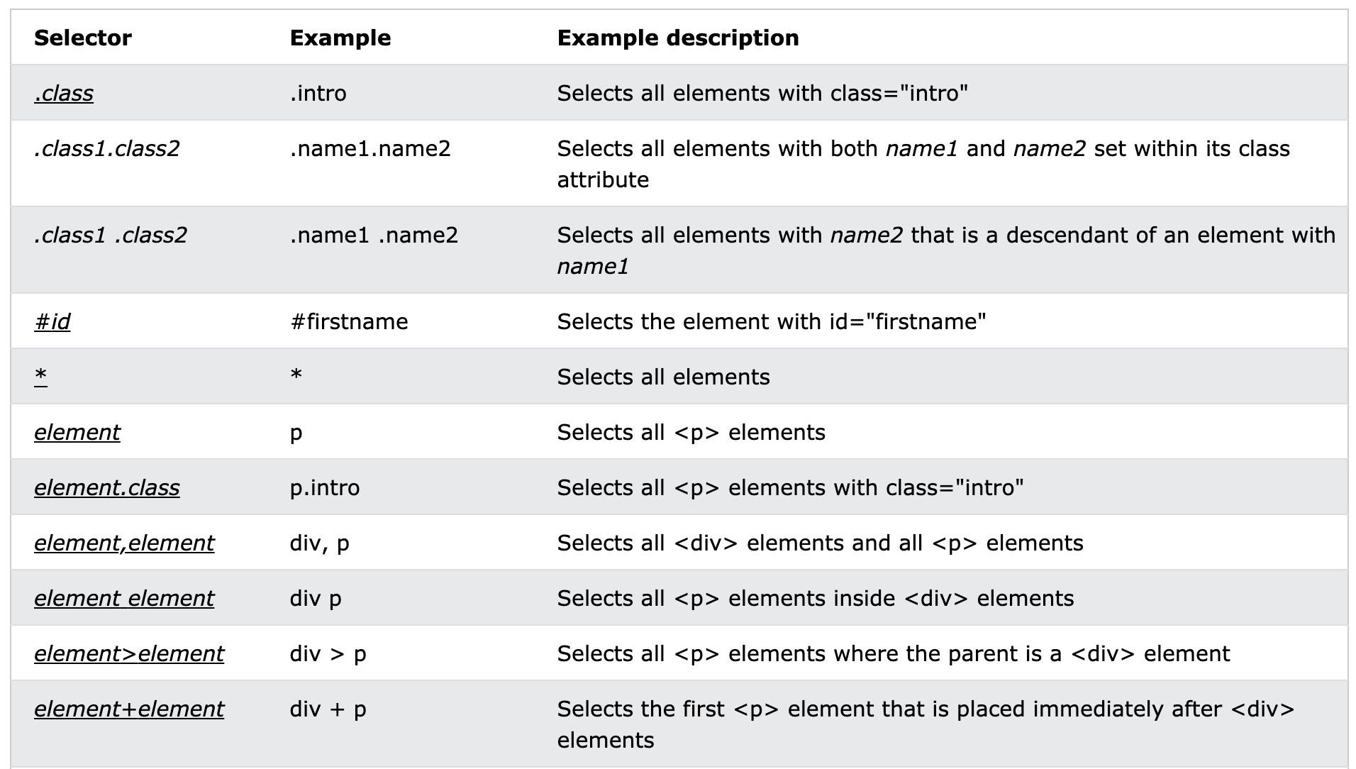

Slide 29
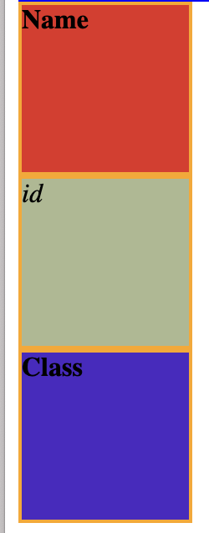
Using querySelector to reference a screen element
<div name="name"></div> <div id="id"></div> <div class="class"></div>
document.querySelector("#id").innerHTML = "<em>id</em>"; document.querySelector(".class").innerHTML = "<b>Class</b>"; document.querySelector("[name=name]").innerHTML = "<b>Name</b>"; document.querySelector("#id").style.backgroundColor = getRandomColor(); document.querySelector(".class").style.backgroundColor = getRandomColor(); document.querySelector("[name=name]").style.backgroundColor = getRandomColor();

Slide 30
Other ways to reference a screen element
querySelector is great of a single element
querySelectorAll will return an array of matching elements
We also have
document.getElementById // returns a single element
document.getElementsByClassName // all matching class name
document.getElementsByName // all matching names
document.getElementsByTagName // all matching tag names

Slide 31
Looking for errors

Slide 32
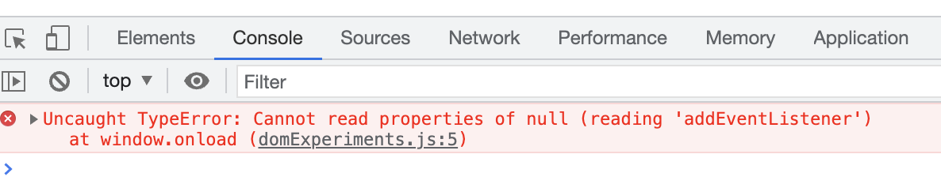
There is something wrong with my JavaScript
Where can you look for errors?
Right click Inspect
Click on the console tab
You can click on the link domExperimetns.js:5
It will take you to the sources tab

Slide 33
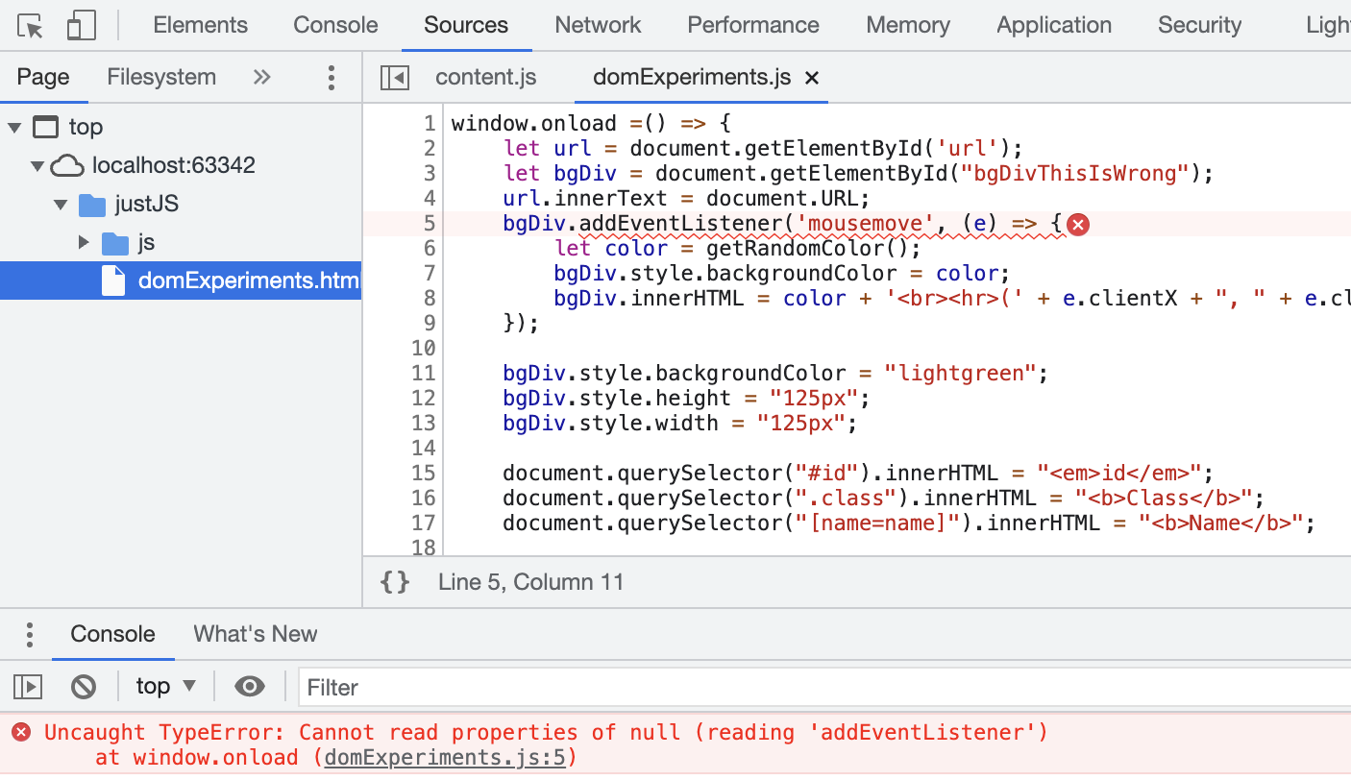
There is something wrong with my JavaScript
You can see that the browser is not happy with line 5
You’ll have to use your big programmer brain to figure out the error
In this case it says it ‘Cannot read properties of null. If you put a break point on this line you will see that bgDiv is null.
Where is it assigned??
On Line 3.
Which means bgDiv was not found in the HTML
Maybe we spelled it wrong

Slide 34
Debugging Tips
console.log and console.table are great for dumping the contents of variables or arrays, respectively
Pepper them through your code and look in the console to see what is happening.
I have added a console.log for the X and Y coords in the sample code for this module. Open the console to see the flow of info

Slide 35
Debugging
Make sure you have a good lint extension added to your editor
In VS Code just search for LINT in the extensions window
I use ESLint but there are many to choose from

Slide 36
Minification
Often you will see Bootstrap CSS or JS file that has .min. in the name
What is going on there?
You can minify (opposite of magnify) your files.
This will strip out all unnecessary white space to make the file smaller and faster loading
It also makes it neigh impossible to read
(not helpful for debugging purposes)

Slide 37
JavaScript Code What is the same with other languages
JS has all the usual constructs from Java and C
if else
switch case
while
for
do while

Slide 38
JavaScript Code What is different with other languages
Variables do not have ‘types’
There are no int, string, long, float key words
How ever a variable CAN contain an int, string, long, or float
And the same variable can at different times be a float or an int or a string
We declare a variable using the let or var key word

Slide 39
Let or var What is the difference?
var was the original variable declaration key word
var firstName, lastName, dateOfBirth;
You could actually just get away with this originally
firstName = “Gary James”;
Bad bad bad!
var makes a variable have global scope
Not a safe practice

Slide 40
Let’s create a variable using let
let functions the same as var
But the scope of a variable declared using let is constrained to the scope in which it is defined
Meaning whatever set of enclosing curly braces defines the scope of the variable’s visability

Slide 41
Naming Conventions
JavaScript follows the usual CamelCase Java naming convention
let firstName, lastName, timeOfDay;
firstName and FirstName are two different variables!
Case matters

Slide 42
A few words on Arrays
Since JavaScript does not have ‘types’ an array does not have a type
let studentInfo = [‘Jack Flash’, 28, ‘blue eyes’, 3.66];
This is a perfectly acceptable array as permitted by JavaScript
let name = studentInfo[0]; // name would contain ‘Jack Flash’
let age = studentInfo[1]; // age would contain 28
let gpa = studentInfo[3]; // gpa would contain 3.66

Slide 43
A few words on Arrays
You can see how ‘convenient’ it is to put everything in an array
We don’t cover JSON yet but you can see how much clearer it would be to have something like this:
let studentInfo = { name : ‘Jack Flash’, age : 28, eyeColor : ‘blue eyes’, gpa : 3.66};
Now we have a JSON object and can use the ‘dot’ operator
studentInfo.name; // when we need the name
studentInfo.age; // when we need the age
studentInfo.gpa; // when we need the gpa

Slide 44
The Bootstrap .js (JavaScript) files can be located on:
Correct Answer all of these answers are correct
your server
the BootstrapCDN
a third party server

Slide 45
In the CSS box model, pick the one that DOES NOT belong:
Margin border padding
Correct Answer spacing
A common file name for the homepage of a website is:
Correct Answer index.html

Slide 46
CSS Ids have greater specificity than classes. If an HTML element is using both id and class attributes, the CSS rule for the id will take precedence over that of the class.

Slide 47
In JavaScript, arguments can be passed to a function that is triggered by an event listener. True
We need to give variables a type when we create them in JavaScript False
It matters where in an html file (the head tag versus after the body, for example) JavaScript is placed True

Slide 48
I want to get something from the html document so that I can do something to it in JavaScript. What should I use? querySelector
Pick the one that is NOT helpful when debugging JavaScript code code minification

Slide 49
I am creating a website. I buy hosting from GoDaddy, and use FTP to transfer my html and image files for the website to the server. Moving my JavaScript code to the web server is un-necessary, since JavaScript is client side. False

Slide 50
JavaScript filenames typically end in: .js
A nice function for displaying the output of a variable in JavaScript is: console.log()

Slide 51
I want to get the URL of the document in JavaScript. I should use ____________.URL document
In JavaScript, you type the following into the console:
document.querySelector(".main-title").innerHTML
you would expect to see something like this... "Welcome to my Homepage"
I want to have a function in JavaScript that runs when the user hovers over an element on my webpage. What should I Google to learn more about this?
Correct Answer JavaScript event handler

Slide 52
A final word to cover that last of the questions in the Quiz
JavaScript is all client side (next week we will discuss server side Node.js)
In fact everything we have covered is client side, HTML, CSS and JS
But they still need to be pushed to your server to be passed on to the browser when requested
JavaScript is hosted on the server but executed in the browser

